Slide 1
18CSC304J COMPILER DESIGN
UNIT 4
SESSION 6

Slide 2
Topics that will be covered
Assignment Statements
Boolean Expressions
Case Statements

Slide 3
ASSIGNMENT STATEMENTS

Slide 4
Assignment Statements
As part of the translation of assignments into three-address code, we will learn
How names can be looked up in the symbol table
How elements of arrays can be accessed
How records can be accessed

Slide 5
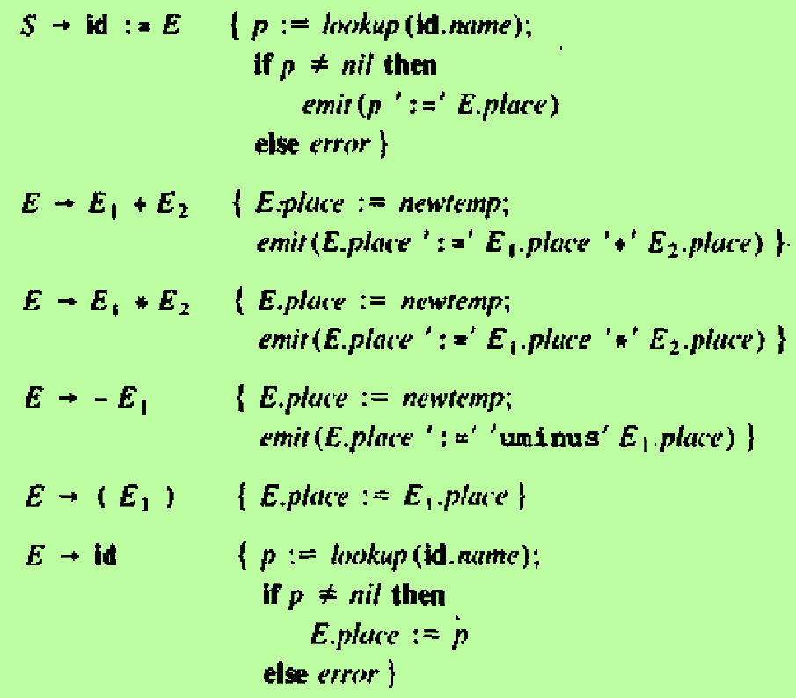
Names in Symbol Table
The lexeme for the name represented by id is given by attribute id.name
The operation lookup(id.name) checks if there is an entry for this occurrence of the name in the symbol table. If so, a pointer to the entry is returned. Otherwise it returns nil to indicate that no entry was found

Slide 6
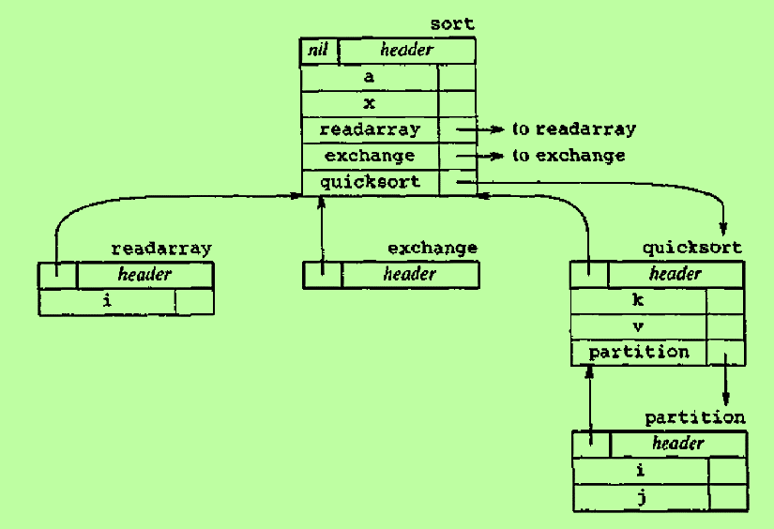
The top of the stack tblptr contains a pointer to the symbol table for the current procedure
When a name is encountered inside a procedure, the lookup operation does the following:
It first checks if the name appears in the current symbol table, accessible through top(tblptr)
If not, the pointer in the header of the table is used to search the symbol table for the enclosing procedure
If the name cannot be found in any of these scopes, then it returns nil
Consider the scenario shown here
For each of these procedures, a separate symbol table is created
Each such symbol table has a header containing a pointer to the table for the enclosing procedure

Slide 7
Assume that the body of procedure partition is examined currently and a name k is used in an expression
lookup(k) will search for the entry k in the symbol table of partition. It is not found
lookup(k) will follow the pointer in header and will search the symbol table of quicksort (enclosing procedure). The name k is found
So, the use of k in an expression in the procedure partition is valid

Slide 8
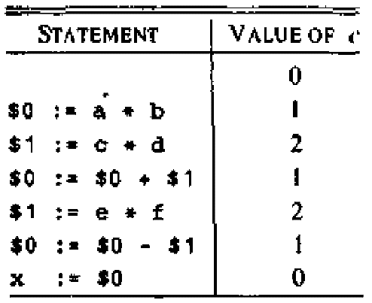
Reusing Temporary Names
We have assumed that “newtemp” generates a new temporary name each time it is called.
Space should be allotted in symbol table to store all the temporary names and their values.
To make use of space efficiently, temporary names can be reused
Initialize a count c to zero
Whenever a new temporary name is generated, use $c and increase c by 1
Whenever a temporary name is used as an operand, decrement c by 1
Example: Consider the assignment x := a * b + c * d – e * f
Three address statements:
Note:
Temporaries that may be used more than once cannot be assigned names in this method
This problem may arise when we perform code optimization such as combining common subexpressions

Slide 9
Addressing Array Elements
Elements of an array are usually stored in a block of consecutive locations
Single Dimensional Array
The i^{th} element of array A begins in location
base + ( i – low ) * w --------------- (1)
where
low → lower bound on the subscript
base → relative address of the storage allocated for the array
The expression 1 can be rewritten as
i * w + ( base – low * w ) ---------(2)
Let c = base – low * w
The subexpression c may be evaluated when the declaration of the array is seen, and c is saved in the symbol table entry for A

Slide 10
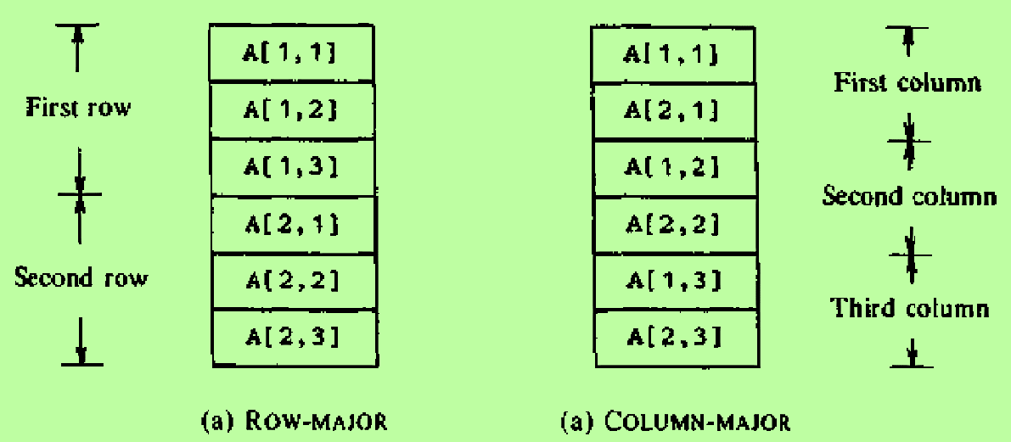
Addressing Array Elements – cont..
Two Dimensional Array
A two dimensional array is normally stored in one of the two forms
Row major (row-by-row)
Column major (column-by-column)
The figure below shows the layout of a 2x3 array A

Slide 11
Addressing Array Elements – cont..
Two Dimensional Array stored in row major form
The relative address of A[i1,i2] can be calculated by the formula
base + ( ( i₁ – low₁ ) * n₂ + i₂ – low₂ ) * w ---------- (3)
where
low₁ → lower bound on the value of i₁
low₂ → lower bound on the value of i₂
n₂ → no of values that i₂ can take
n₂ = high₂ – low₂ + 2
high₂ → upper bound on the value of i₂
Assuming that i₁ and i₂ are the only values that are not known at compile time, expression 3 can be written as
( ( i1 * n2 ) + i2 ) * w + ( base – ( low1 * n2 ) + low2 ) * w ---------- (4)
The second term in this expression can be determined at compile time

Slide 12
Addressing Array Elements – cont..
Multi Dimensional Array
The relative address of A[i₁,i₂,…,i_{k}] can be found by the expression
( (…( ( i₁n₂ + i₂ ) n₃ )… ) n_{k} + i_{k} ) * w + base – ( ( … ( ( low₁n₂ + low₂ ) n₃ + low₃ ) … ) n_{k} + low_{k} ) * w ---- (5)
The second term (in blue) can be computed by the compiler and saved with the symbol-table entry for A, since, for all values of j, n_{j} = high_{j} – low_{j} + 1 is fixed
The first term can be generated by the recurrence
e = i₁
e_{m} = e_{m-1} * n_{m} + i_{m}
Some languages permit the sizes of arrays to be specified dynamically at run-time.
The formulas for accessing the elements of such arrays are the same as for fixed-size arrays, but the upper and lower limits are not known at compile time
…….. (6)

Slide 13
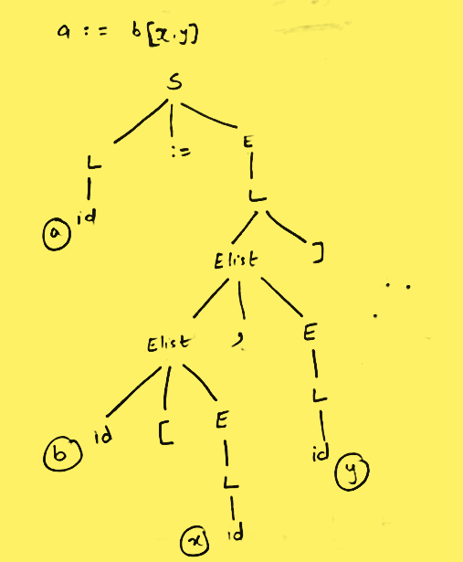
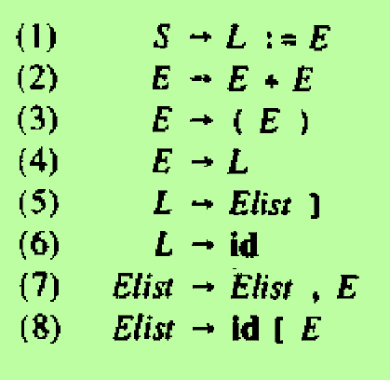
Grammar for addressing array elements

Slide 14
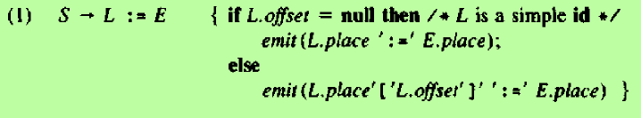
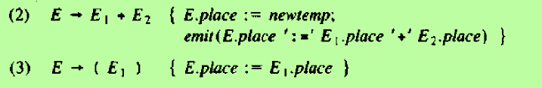
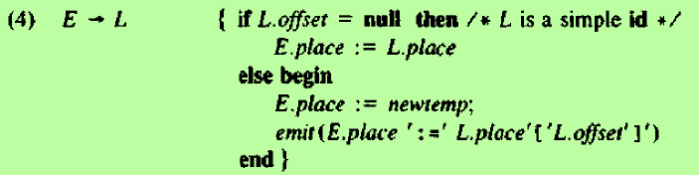
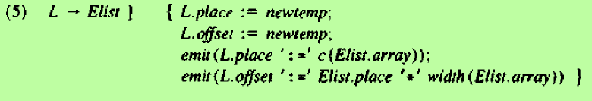
Translation Scheme for addressing array elements
If L is a simple name, a normal assignment will be generated; otherwise, an indexed assignment is generated
Code for arithmetic expressions
When an array reference L is reduced to E, we want the r-value of L. We use indexing to obtain the contents of the location L.place[L.offset]
L.offset is a new temporary representing the first term of expression (5)
Note: The function c(Elist.array) returns the second term of expression (5)

Slide 15
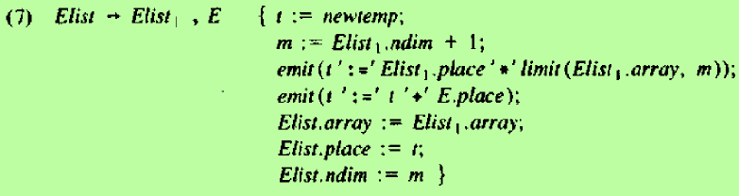

Translation Scheme for addressing array elements – cont..
A null offset indicates a simple name
Elist1.place corresponds to e_{m-1} in expression (6) and Elist.place corresponds to e_{m}
E.Place holds both the value of the expression E and the value of expression (5) for m=1
Note:
The function limit(array,m) returns the number of elements along the j^{th} dimension of the array n_{j}

Slide 16
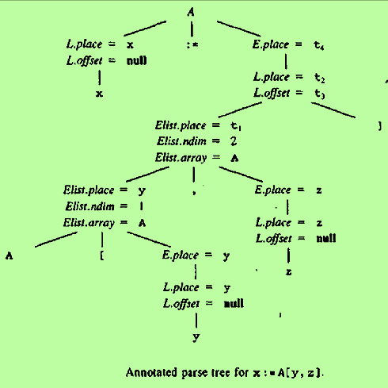
Example:
Let A be a 10x20 array with low1=low2=1
Therefore, n1=10 and n2=20
Take w=4
Use the formula
( ( i1 * n2 ) + i2 ) * w + ( base – ( low1 * n2 ) + low2 ) * w
The second term is the constant c
Consider the statement x := A[y,z]
Here i1=y and i2=z. The expression now becomes
( ( y * 20 ) + z ) * 4 + c
Three address code:
t1 := y * 20
t1 := t1 + z
t2 := c
t3 := 4 * t1
t4 := t2 [ t3 ]
x := t4

Slide 17
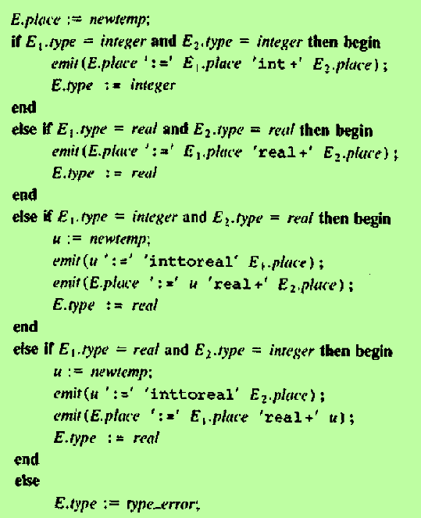
Type conversions within Assignments
Semantic action for E → E1 + E2
In a program there will be many different types of variables and constants
So the compiler must either reject certain mixed-type operations or generate appropriate type conversion instructions
Suppose there are two types – real and integer with integers converted to reals when necessary
Example
Consider the input
x := y + i * j
Assuming x and y have type real and i and j have type integer
t1 := i int* j (integer multiplication)
t2 := inttoreal t1 (convert int to real)
t3 := y real+ t2 (floating-point addition)
x := t3

Slide 18
BOOLEAN EXPRESSIONS

Slide 19
Boolean Expressions
In programming languages, Boolean expressions have 2 primary purposes
They are used to compute logical values
They are used as conditional expressions in statements that alter the flow of control such as if-then, if-then-else and while-do statements
Boolean expressions are composed of Boolean operators (and, or, and, not) applied to elements that are Boolean variables or relational expressions
Grammar for Boolean expressions
E → E or E | E and E | not E | (E) | id relop id | true | false

Slide 20
Methods of Translating Boolean Expressions
Encode true and false numerically
Examples:
True is denoted by 1 and false by 0
Any non-zero quantity denotes true and 0 denotes false
Any non-negative quantity denotes true and a negative quantity denotes false
Represent the value of an expression by a position reached in a program

Slide 21
Numerical Representation
Consider the implementation of Boolean expressions using 1 to denote true and 0 to denote false
Example:
Translation for a or b and not c is
t1 := not c
t2 := b and t1
t3 := a or t2
Example:
Consider the relational expression a<b
It is equivalent to the conditional statement if a<b then 1 else 0
Three address code:
100: if a<b goto 103
101: t := 0
102: goto 104
103: t :=1
104:

Slide 22
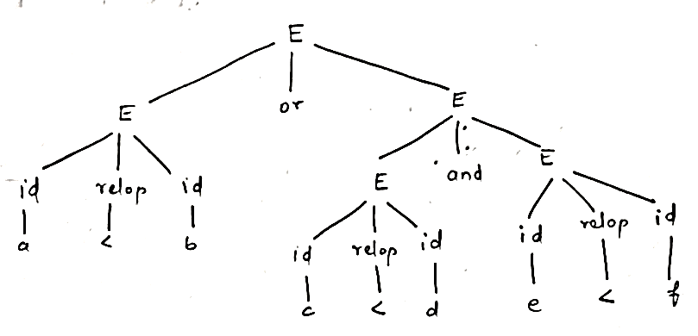
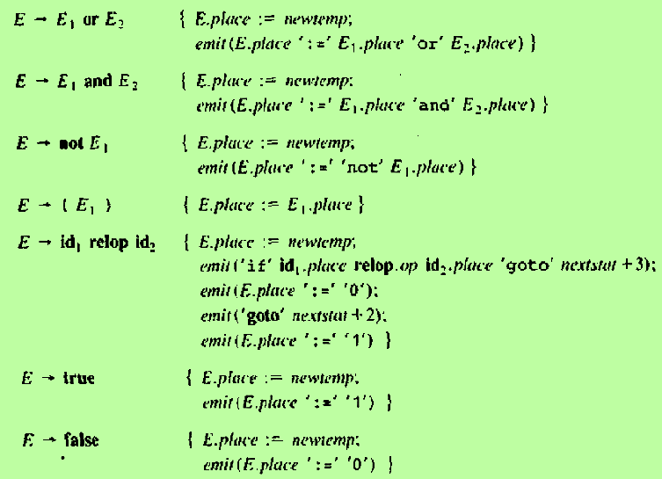
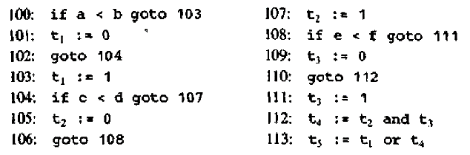
Translation Scheme
Assume
nextstat gives the index of the next three address statement
emit increments nextstat after producing each 3-address statement
Annotated parse tree for the expression
a<b or c<d and e<f
E.place=t₅
E.place=t₄
E.place=t₁
E.place=t₂
E.place=t₃

Slide 23
Short-Circuit Code
We can translate a Boolean expression into three-address code without generating code for any of the Boolean operators and without having the code to evaluate the entire expression
This style of evaluation is called “short-circuit” or “jumping” code

Slide 24
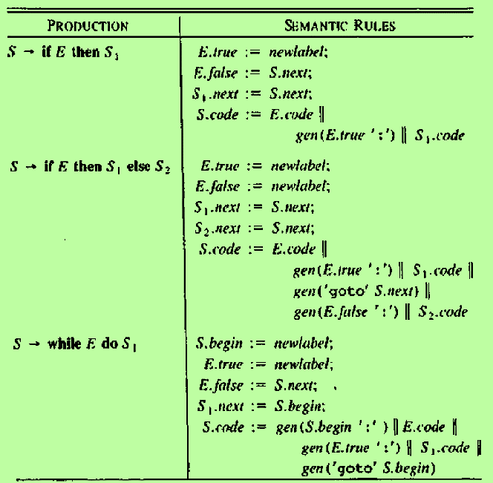
Flow of Control Statements
Syntax directed definition
The grammar for if-then, if-then-else and while-do statements is
S → if E then S1 |
if E then S1 else S2 |
while E do S1
Three address statements are symbolically labelled
A function newlabel returns a new symbolic label each time it is called
Two labels are associated with a Boolean expression E
E.true – the label to which control flows if E is true
E.false – the label to which control flows if E is false
S.next is an inherited attribute. It is a label that is attached to the first three-address instruction to be executed after the code for S
The code for E generates a jump to E.true if E is true and a jump to E.false if E is false

Slide 25
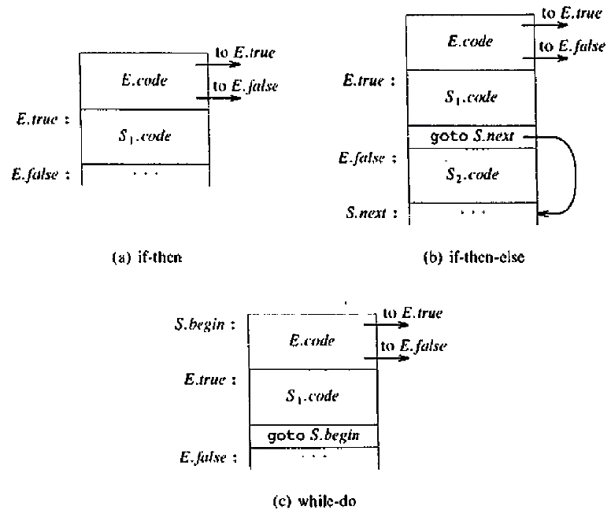
Flow of Control Statements – cont..
Syntax directed definition

Slide 26
Control Flow Translation of Boolean Expressions
We can discuss E.code, the code produce for the Boolean expressions E in the previous syntax directed definition
Suppose E is of the form a < b, the generated code is of the form
if a<b goto E.true
goto E.false
Suppose E is of the form E1 or E2,
If E1 is true, then we need not evaluate E2. We immediately know that E itself is true. So E1.true is the same as E.true
If E1 is false, then E2 must be evaluated. So E1.false is the label of the first statement in the code for E2
No code is needed for an expression E of the form not E1

Slide 27
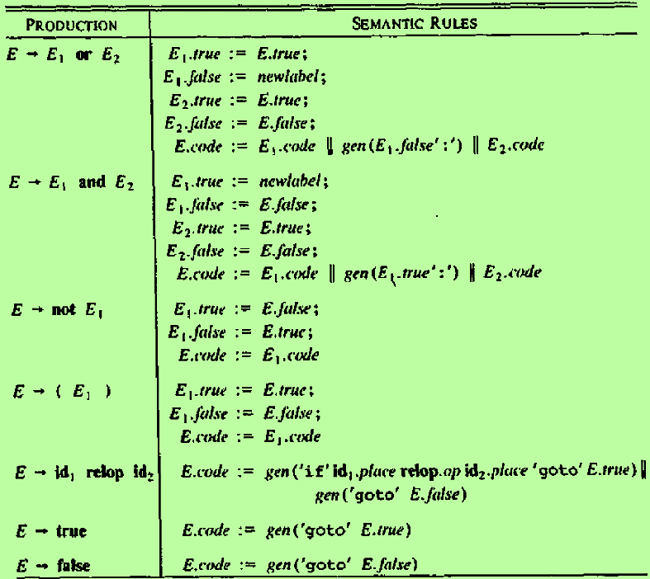
Control Flow Translation of Boolean Expressions – cont..
Example:
The statement a<b or c<d and e<f produces the following code:
if a<b goto L.true
goto L1
L1: if c<d goto L2
goto L.false
L2 : if e<f goto L.true
goto L.false

Slide 28
CASE STATEMENTS

Slide 29
Case Statements
The “switch” or “case” statement is available in a variety of languages
Syntax of switch statement
switch expression
begin
case value: statement
case value: statement
…
case value: statement
default: statement
end

Slide 30
The intended translation of a switch
Evaluate the expression
Find which value in the list of cases is the same as the value of the expression. The default value matches the expression if none of the values in the cases match
Execute the statement associated with the value found

Slide 31
Implementing n-way branch
If the number of cases is not too great, say 10 at most, then a sequence of conditional goto’s can be used
A more compact way to implement this sequence of conditional goto’s is to create a table of
pairs:
If the number of values exceeds 10 or so, it is more efficient to construct a hash table for the values, with the labels of various statements as entries
A more efficient implementation: If all the values lie in some small range say i_{min} to i_{max} and the number of values is a reasonable fraction of i_{max}-i_{min}, then an array of labels can be constructed, with the label of the statement for value j in the entry of the table with offset j-i_{min}

Slide 32
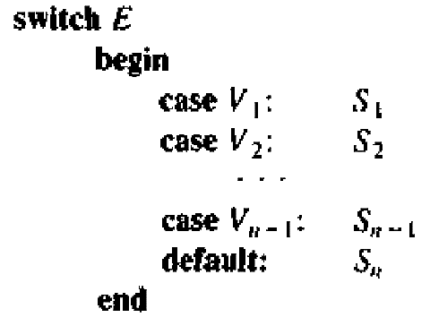
Syntax Directed Translation of Case Statements
Consider the following switch statement:
Steps involved in Translation:
When the keyword ‘switch’ is seen, generate two labels test and next and a new temporary t
As the expression E is parsed, generate code to evaluate E into t
3. After processing E, generate the jump
goto test
When the keyword ‘case’ is seen, create a new label Li and enter it into the symbol table. A pointer to this symbol-table entry and the value Vi are placed on a stack
When the statement case Vi: Si is processed, emit the newly created label Li, followed by the code for Si, followed by ‘goto next’
When the keyword ‘end’ is found, read the pointer-value pairs on the stack from the bottom to the top and generate three-address statements

Slide 33
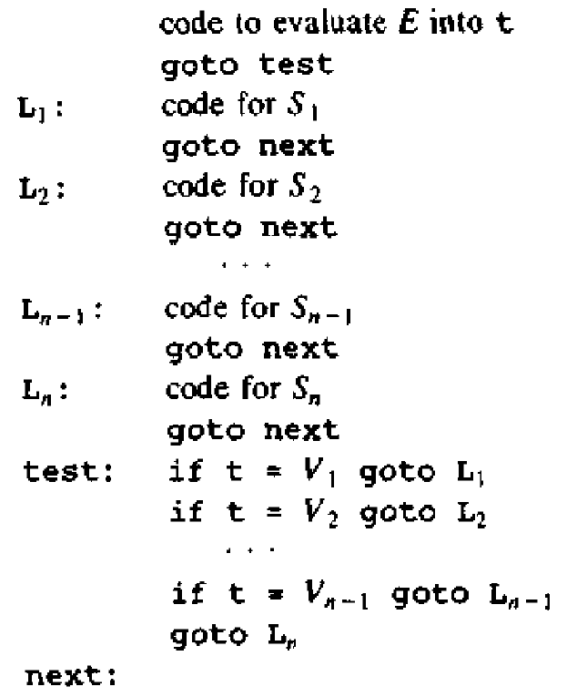
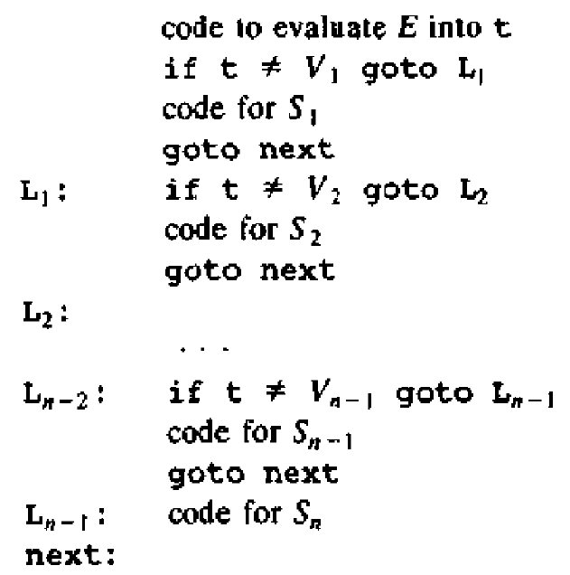
Two ways of translation of a case statement

